Slide 1
What is Application?
Application is a peace of code that satisfy end user requirement
Example: Calculator

Slide 2
Additional example
#include <stdio.h>
int main() {
int number1, number2, sum;
printf("Enter two integers: ");
scanf("%d %d", &number1, &number2);
// calculating sum
sum = number1 + number2;
printf("%d + %d = %d", number1, number2, sum);
return 0;
}

Slide 3
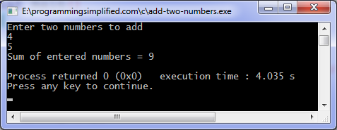
output

Slide 4
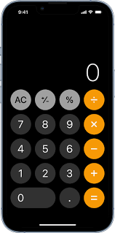
Example

Slide 5
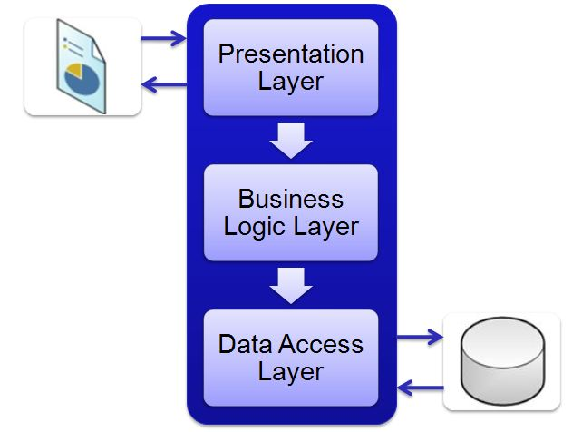
Layer architecture of application

Slide 6
Presentation logic
Purpose: Look and feel
Example: Screen, button

Slide 7
Business logic
[+] [-] [*] [/]

Slide 8
Data logic

Slide 9
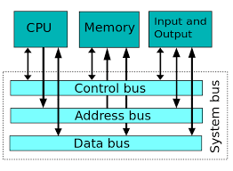
Databus vs Address Bus

Slide 10
RAM
Random-access memory (RAM; /ræm/) is a form of computer memory that can be read and changed in any order, typically used to store working data and machine code.
8 GB RAM

Slide 11
ROM
Read-only memory (ROM) is a type of non-volatile memory used in computers and other electronic devices.

Slide 12
Virtual Machine
Combination of ROM and RAM

Slide 13
CPU
Central processing logic which has arithmetic and business logic

Slide 14
Resources category
Compute, storage, networking and database

Slide 15
Category of application(Bank)
24*7 Application(OTP, Mobile banking)
Business Application(Loan approval)
Pipeline application(Application development is going on)

Slide 16
Phase to build Application(SDLC)
Plan > Code > Build > Test
Deploy > Release > Operate > Monitor

